Slide 1
Education under Sail
Examples of successful Sail Training programmes in the UK
Lucy Gross, General Manager
Association of Sail Training Organisations
Notes:
Umbrella body for Sail Training in UK
Formed in 70s by several ST organisations
STA, OYC, LSP

Slide 2
ASTO
33 member organisations
Over 50 vessels
10,000 young people and 2000 people with disabilities each year
7000 days at sea
April to October
Notes:
Today: 33 member organisations each run their own vessels
50 vessels; from 35 foot modern yachts, to 70 foot pilot cutters, to 65 m Tall Ships.

Slide 3
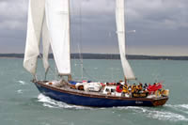
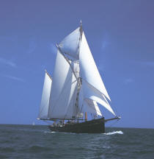
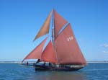
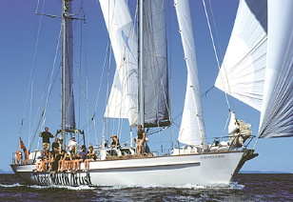
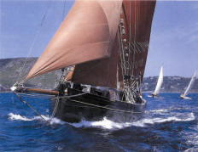
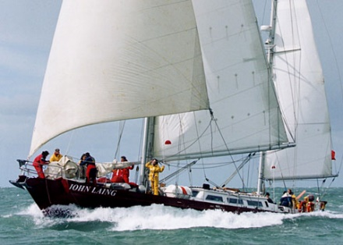
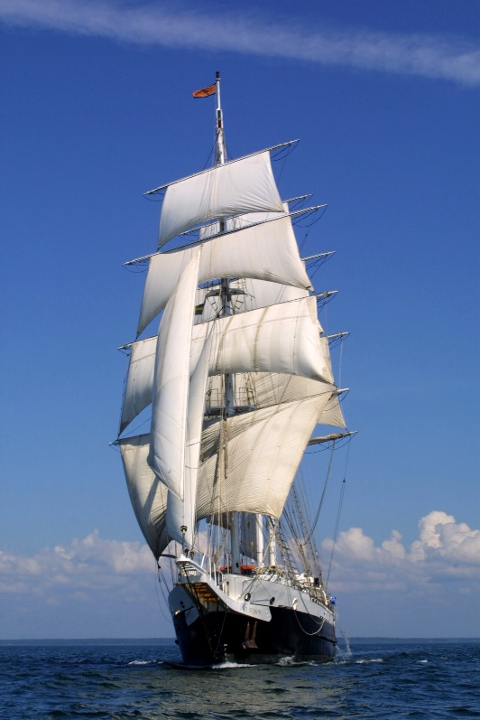
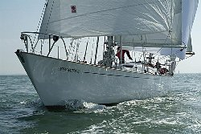
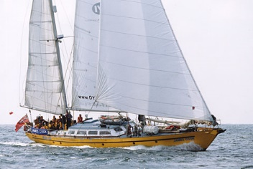
Notes:
What types of vessels
Most are around 20 – 24 m
Around 16 are gaff rigged
Around 26 modern Bermudan rigged
5 square rigged (2 miniature square rig)
Even have 2 power vessels
Around 16 historic vessels (built before 1940)
Suitable to stay on overnight
Type of vessel matters less as they all need teamwork to function, on all of them you need to respect each others space, all of them are exciting in their own way.

Slide 4
Sail Training
‘to provide instruction to young persons and to adults with disabilities in the principles of responsibility, resourcefulness, loyalty and team endeavour’
‘To advance education in the art of Seamanship’
Notes:
ST as a concept in UK existed since 1950s
STA, OYC and LSP
not about learning how to sail
learning personal or life skills from it
Using the vessels as a tool to learn life skills
Definition of ST

Slide 5
Problem solving
Communication
Self discipline
Adventure
Confidence
Team Work
overcome difficulties
Notes:
This is what we are trying to achieve, what Sail Training does
Life skills
Plus other skills like cooking, getting up on time, looking after yourself, pushing yourself, making new friends

Slide 6
Notes:
Types of groups:
School groups - Two vessels owned by schools, other schools charter time on vessels
Youth groups like scouts
Ill children – one boat takes out children recovering from cancer
Young carers, young people who look after ill relatives or parents
Young people that have been excluded for difficult behaviour at school
Young people that have left school early and are without qualification
Unemployed young people
People with disabilities – visually impaired, hearing impaired, physical disablities

Slide 7
Notes:
Typical voyage
Typically 5 to 7 days on board
Typically groups of 12 young people with 4 staff (can be volunteers or professionals)
No previous sailing experience necessary
Thorough familiarisation with the vessel, including safety equipment
Shorter voyage initially to practice sailing manoeuvres, go to a new port
Trainees are the crew, staff should only be teaching and supervising: ‘hands in pockets’
Put into watches
Given early responsibility
Towards the end of the week they should be able to set sail, shape a course and run the routine of the vessel
Toward the end of the week a much longer challenging sail, ideally overnight
On top of this the trainees do the cooking and keeping the boat clean, tidy and ship shape

Slide 8
Cat Zero
Notes:
Programme in the north east of England, Hull and Humber region
Quite a dull picture so I’ll skip to a more exciting one

Slide 9
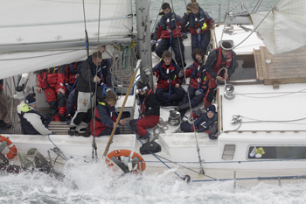
Cat Zero
Young people that are unemployed
Notes:
Very high youth unemployment
NEET – not in education, employment or training
Health problems, drug misuse, turn to crime
High cost to the taxpayer
Innovative programme of intervention
Funding from health service
‘improves the lives of individuals as well as the community’
Specifically
Teach skills incl Engine maintenance and navigation, interview technique, personal presentation
10 day sailing challenge where they stay at sea.
On board they learn time keeping, self discipline, overcoming adversity (sea sickness), sense of camaraderie, perseverance
Once back ashore, set achievable goals, keeping new positive attitude, apply for apprenticeships or go back to school.
70% success rate

Slide 10
Notes:
Swan of Shetland
Restored Fifie herring drifter
Built 1900, restored 1990
Supported by Shetland council
Shetland quite small island chain
Aim to get every school child on board at some point
School trips 2 – 3 hours
Includes teachers – great for fostering trust as they are learning new things together
During summer holidays do longer trips with older children 15 upwards
Corporate day trips to make an income
Charity – volunteer committees and two paid staff

Slide 11
Other programmes
Merchant Navy cadets
Duke of Edinburgh award scheme
Link with school curriculum
Coastal transport/ Fair Trade/ low carbon
Small Ships Races
Engage with schools and existing youth groups
Notes:
MN cadets
JST and OYT Scotland
Need sea time for trainees
College pays for the placement (often sponsored by large shipping companies)
Mental health
Stress/anxiety – could be some health funding
D of E highly respected programme, needs residential trip – ST is perfect
Link with school curriculum – teach biology, physics, ecology, design on board
Small Ships Races
Crews 12 - 25

Slide 12
How they do it
Notes:
In kind support – paint, engine parts, mooring fees
Volunteer labour
Sustainable – many of the skippers and volunteers used to be trainees
Learn to love the ships so want to maintain them
Not passengers have worked out regulation with MCA
History of charitable giving in UK

Slide 13
office@asto.org.uk
www.uksailtraining.org

